Slide 1
Introduction to Cybersecurity
Sreya Vangara

Slide 2
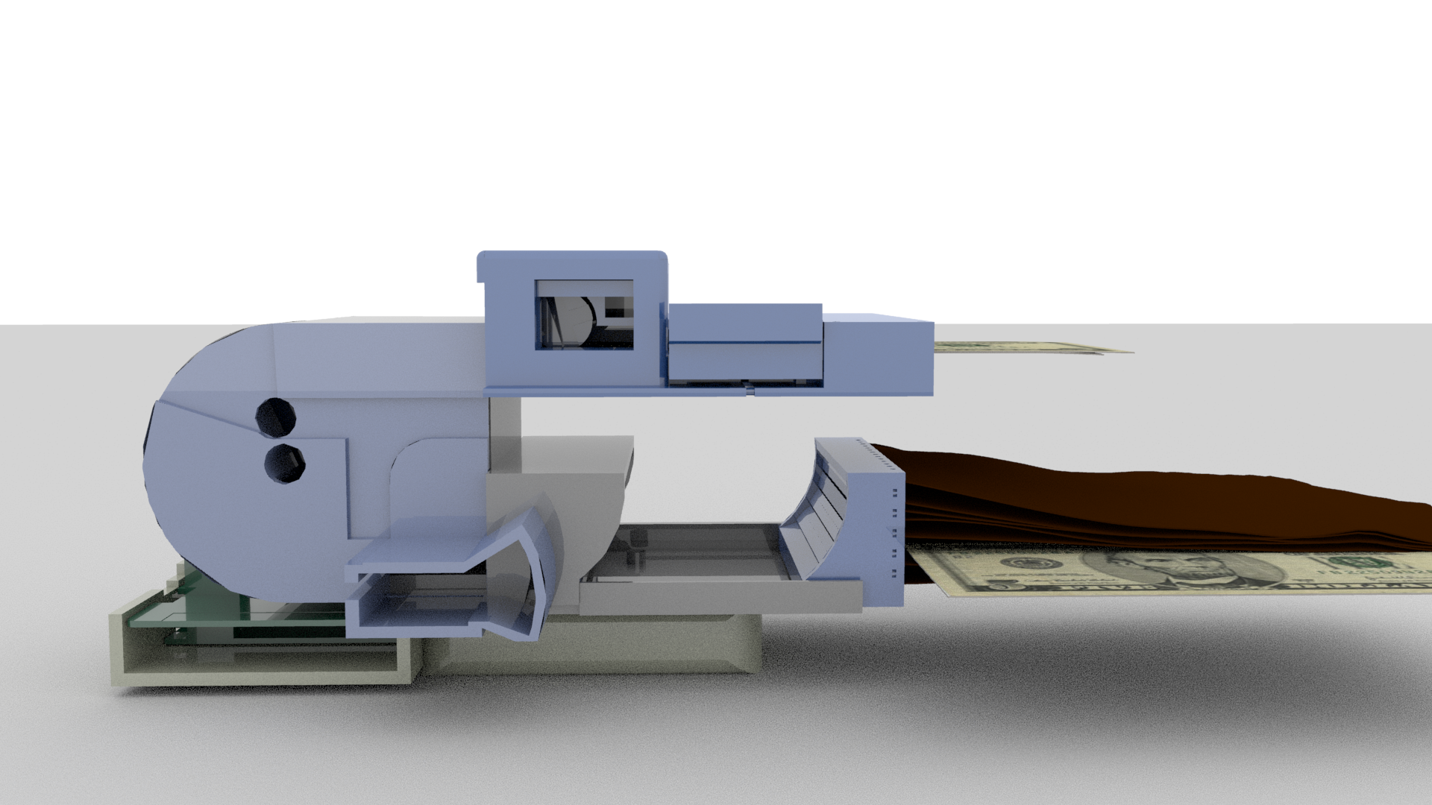
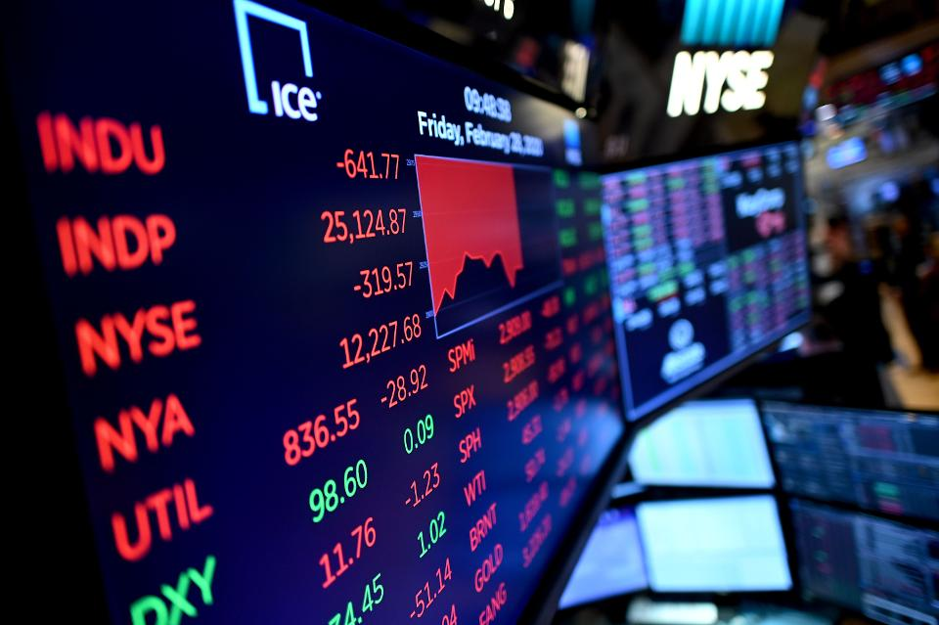
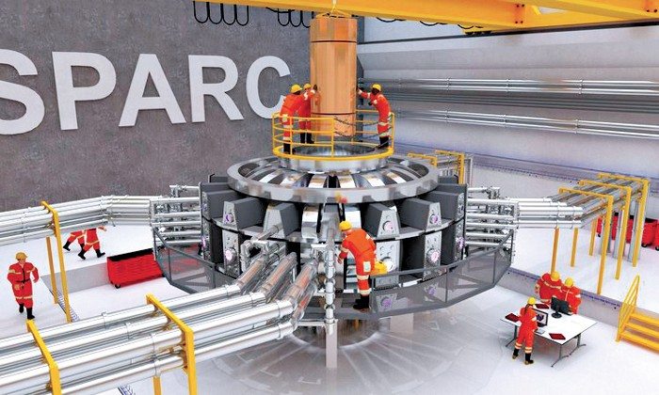


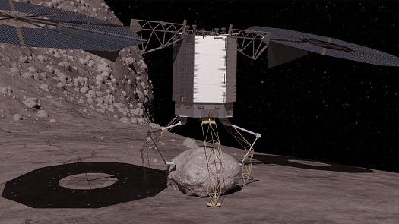

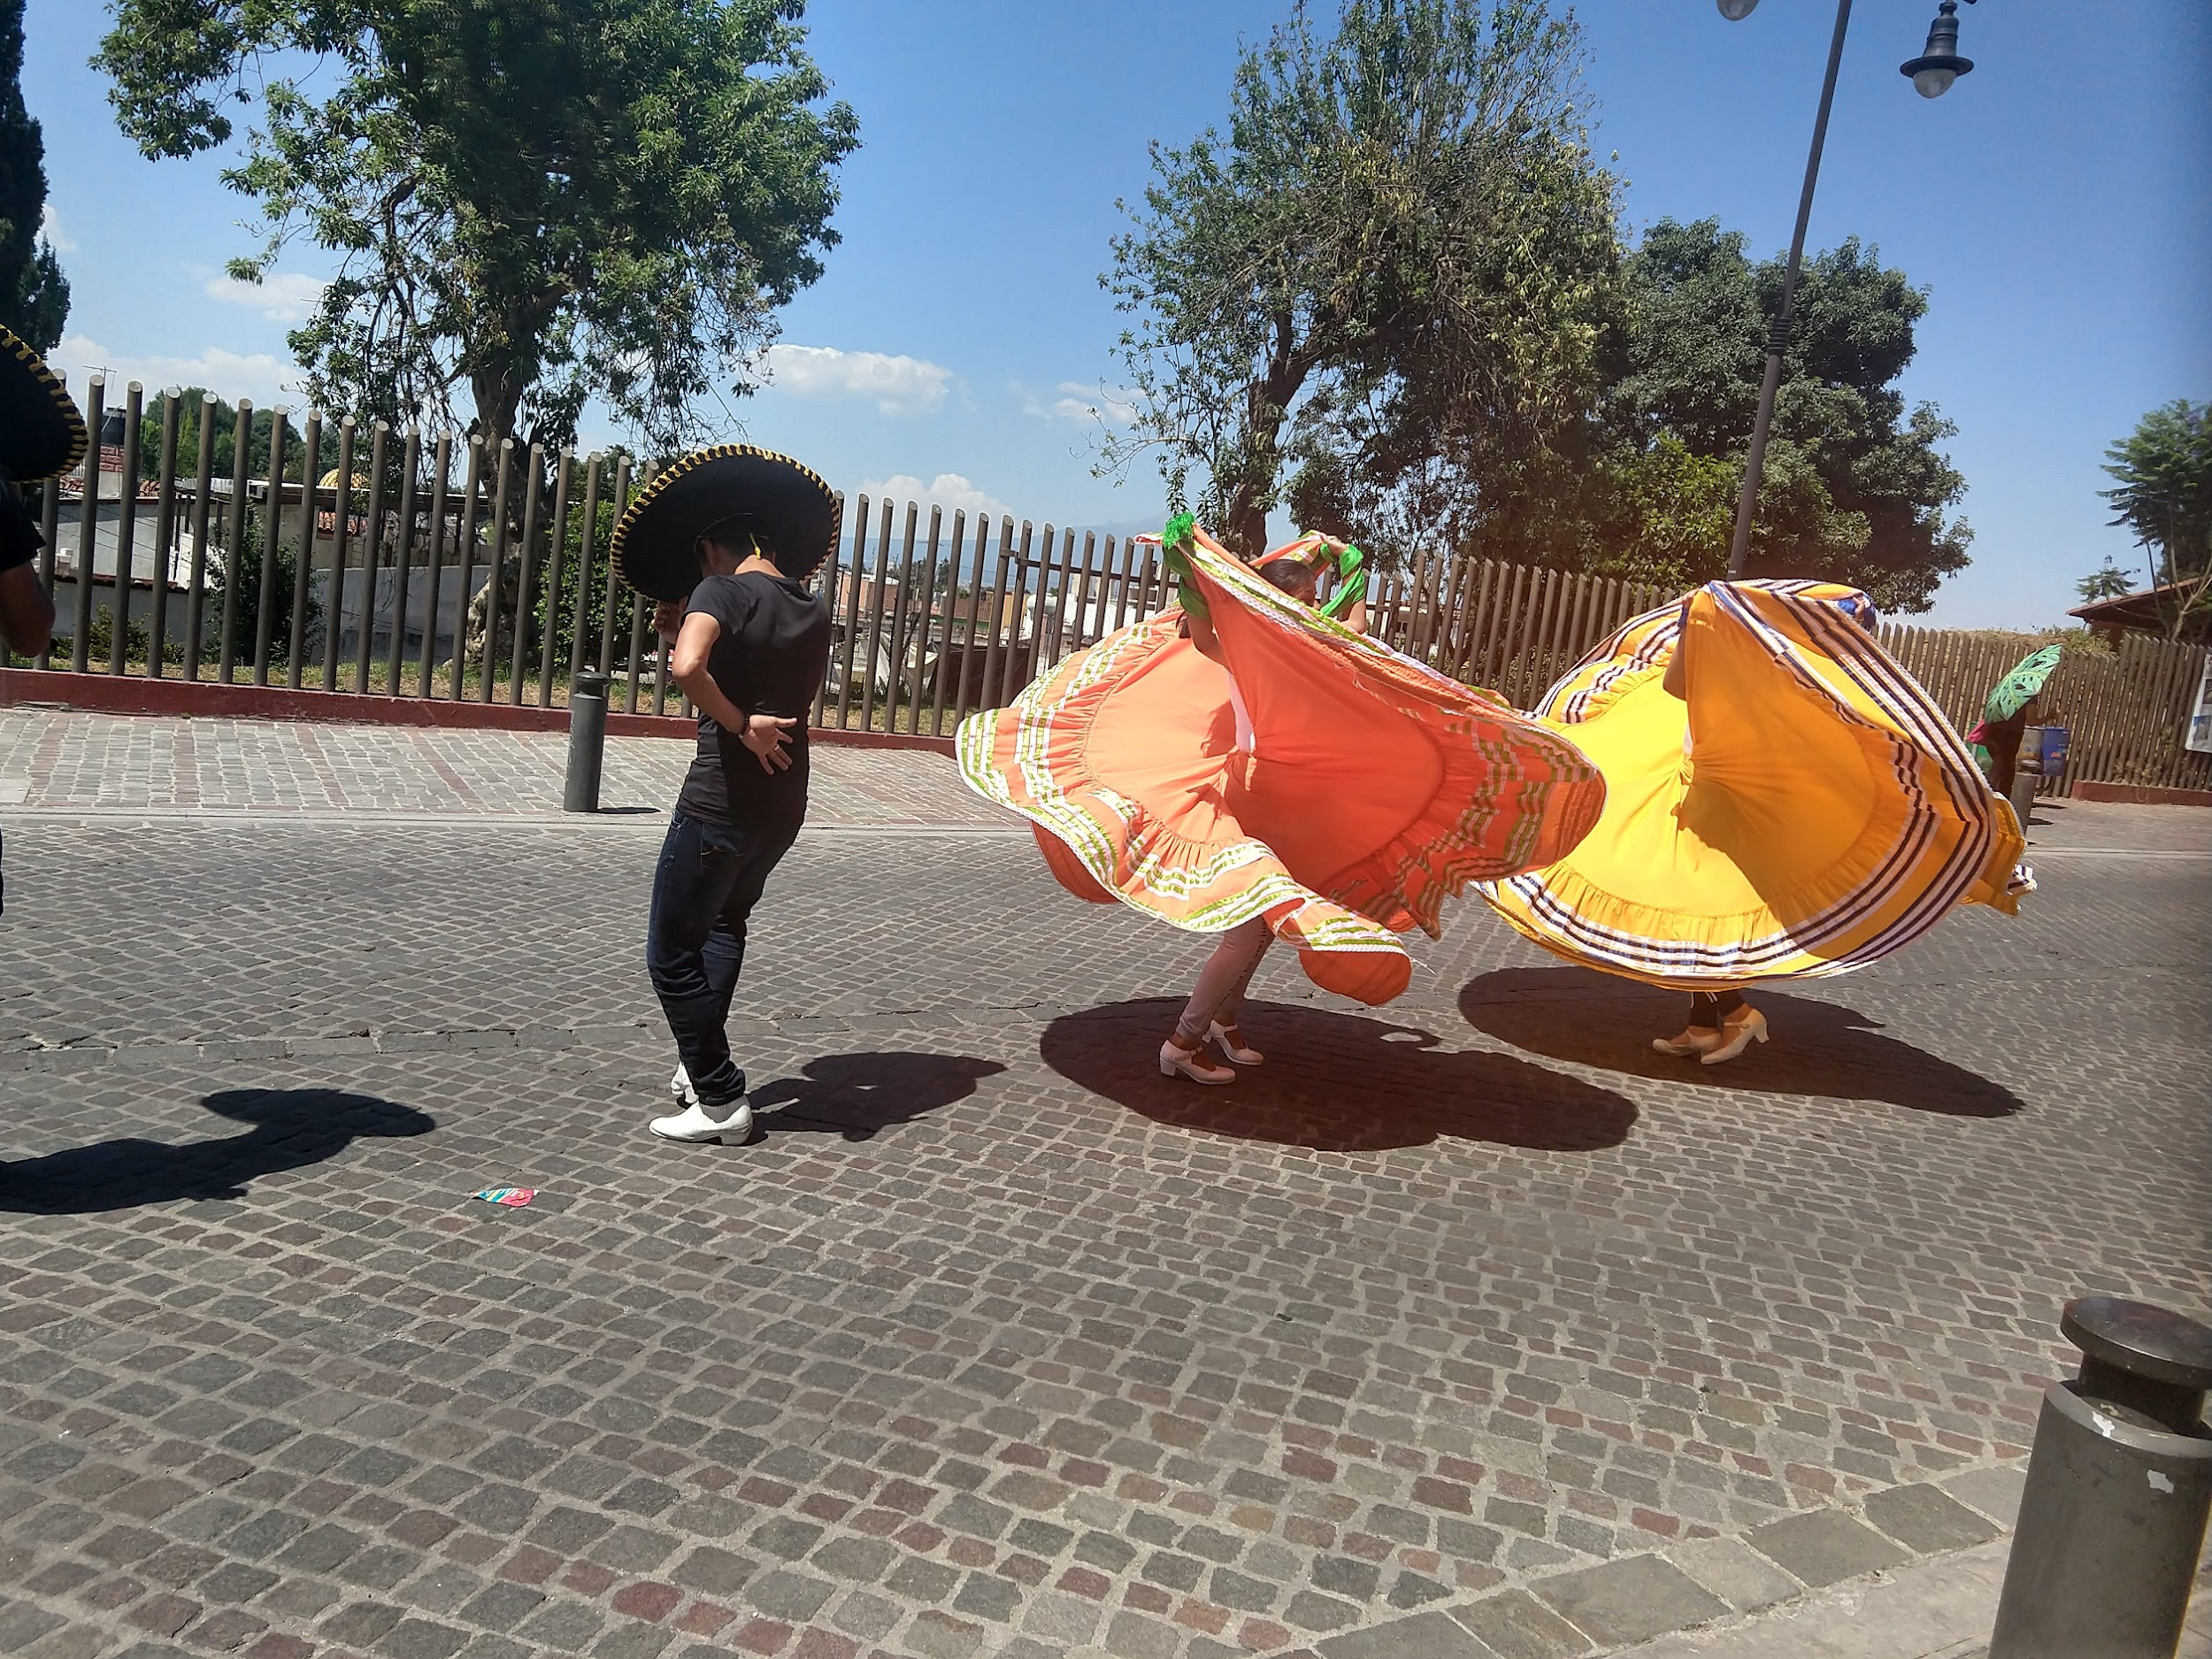

Slide 3
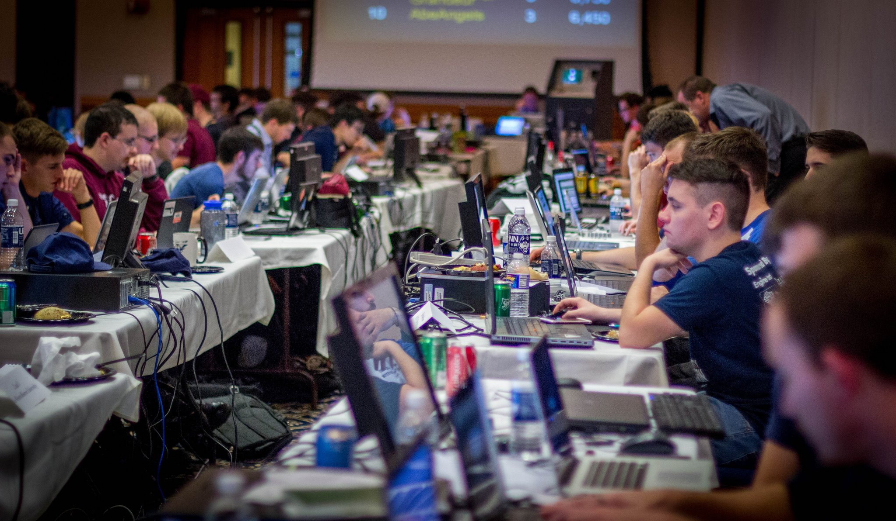

How I Got Into CyberSecurity
Capture the Flag Competitions
CyberPatriot
Playing around with “hacking” tools
Wireshark
Kali Linux
Internships
Form Connections
Keeping up with the CyberSecurity world

Slide 4
What is Cybersecurity?
The Protection and Defense of Technology

Slide 5

What Counts?
Cryptography
Steganography
Reverse Engineering
Binary Exploitation
Networking
Talking to People!
White Hat v.s. Black Hat Hacking

Slide 6

Structure of the Course
Delve into a different subject area each day
Small lesson, majority of the time focused on solving problems
Dive into the larger-context of the topic

Slide 7
https://github.com/SreyaV/cyber-class

Slide 8
Bases and Encoding

Slide 9
How Do Number Systems Work?
Base 10
1 6, 2 8 3
1 * 10⁴
6 * 10³
2 * 10²
8 * 10¹
3 * 10⁰
10000 + 6000 + 200 + 80 + 3

Slide 10
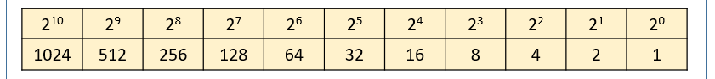
How Does Binary Work?
Base 2

Slide 11
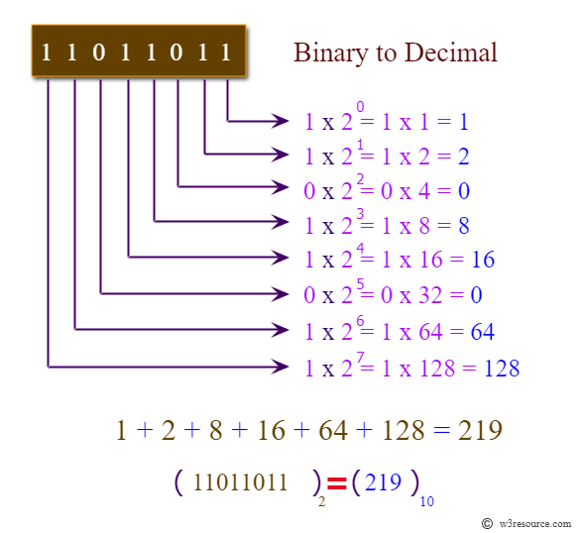
How Does
Binary Work?
Base 2

Slide 12
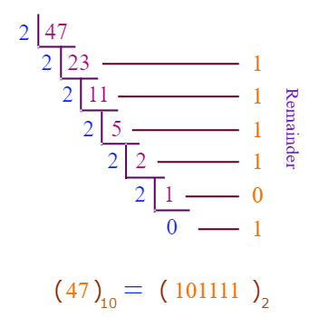
Decimal to
Binary?

Slide 13
Problems
Convert 110101 from binary to decimal.
Convert 231 from decimal to binary

Slide 15
Other Encoding Systems?
Hexadecimal (Base 16)
Digits: 0 1 2 3 4 5 6 7 8 9 A B C D E F
Denoted by 0xHex Number
Octal (Base 8)
ASCII (To Encode Text)
127 Character:Number Mappings

Slide 16
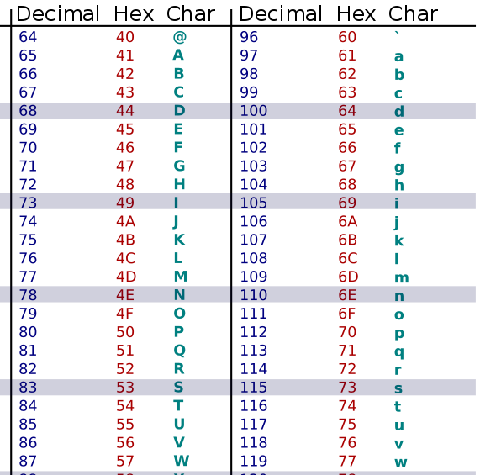
ASCII Table

Slide 17
Problems
Convert 0x3C2 from hex to decimal
Convert 0x41 from hex to ASCII
How many binary digits do you need to represent any ASCII character?

Slide 19
Ciphers

Slide 20
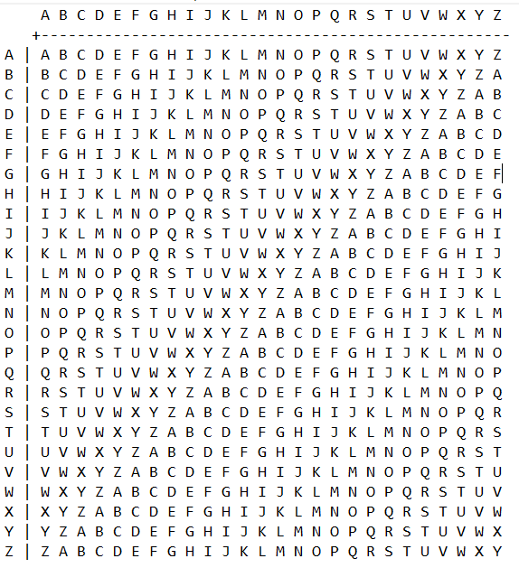
Can You
Decode This?
Ciphered Message:
llkjmlmpadkkc
Key:
thisisalilkey
Notes:
Secret message

Slide 21
Vigenere Cipher
To decrypt, take the first letter of the ciphertext and the first letter of the key, and subtract their value If the result is negative, add 26. The result gives the rank of the plain letter.
To encrypt, take the first letter of the message and the first letter of the key, add their value. The result of the addition modulo 26 gives the rank of the ciphered letter.

Slide 22
Can You Crack This?
guvf_vf_pelcgb!
Notes:
This_is_crypto!

Slide 23
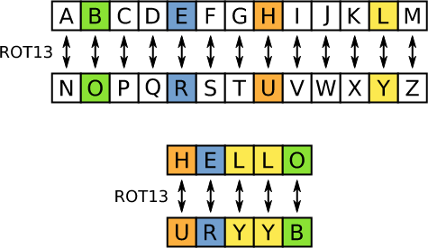
ROT Ciphers

Slide 24
Hashing

Slide 25
Can you decode these?
C017dcaadb04d44b6012b2a055786c77
e10adc3949ba59abbe56e057f20f883e

Slide 26
What is a Hash Function?
A hash function is where a computer takes an input of any length and content (e.g. letters, numbers, and symbols) and uses a mathematical formula to chop it, mix it up, and produce an output of a specific length.

Slide 27
Why do we need Hash Functions?
Message Integrity
One-Way Encryption
MD5 (Message Digest) : 32 chars
SHA3–512 (Secure Hash Algorithm 3) : 128 chars

Slide 28
How to Crack Hashes?
Difficulty varies with length of hash
Rainbow tables
Trial and Error
How can we protect against attacks?

Slide 29
Can You Crack This?
https://raw.githubusercontent.com/SreyaV/cyber-class/master/materials/Day1/HashOnHash.txt
Hint 1: Use Python (or any coding language you are familiar with)
Hint 2: The “flag” will be between two braces {flag text}

Slide 30
Solution
Im far too lazy to put anything meaningful here. Instead, here's some information about what you just solved.
The MD5 algorithm is a widely used hash function producing a 128-bit hash value. Although MD5 was initially designed to be used as a cryptographic hash function, it has been found to suffer from extensive vulnerabilities. It can still be used as a checksum to verify data integrity, but only against unintentional corruption.
Like most hash functions, MD5 is neither encryption nor encoding. It can be cracked by brute-force attack and suffers from extensive vulnerabilities as detailed in the security section below.
MD5 was designed by Ronald Rivest in 1991 to replace an earlier hash function MD4.[3] The source code in RFC 1321 contains a "by attribution" RSA license. The abbreviation "MD" stands for "Message Digest."
The security of the MD5 has been severely compromised, with its weaknesses having been exploited in the field, most infamously by the Flame malware in 2012. The CMU Software Engineering Institute considers MD5 essentially "cryptographically broken and unsuitable for further use".[4]
easyctf{1_h0p3_y0u_d1dn7_d0_7h47_by_h4nd}

Slide 31

Enigma Machine
Used by German Intelligence during World War II
Cracked by Alan Turing, along with significant intelligence efforts by the Brits and Poles
Poor operating practices by the Germans greatly aided in reverse-engineering the code

Slide 32
See you Tomorrow!

